Slide 1
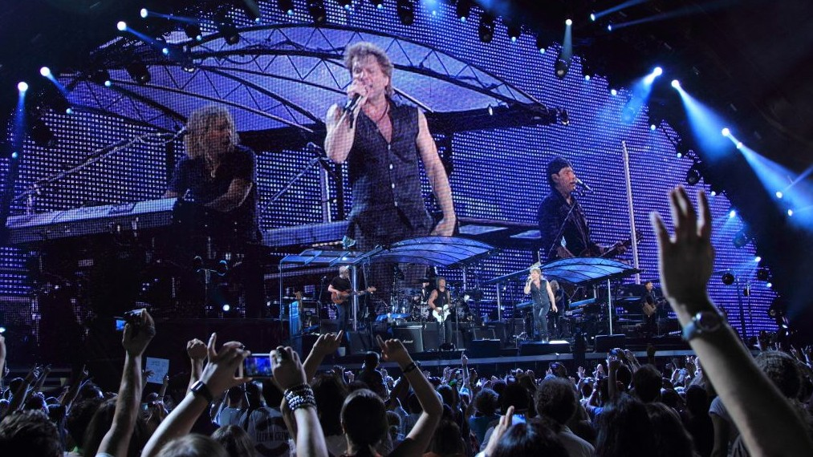
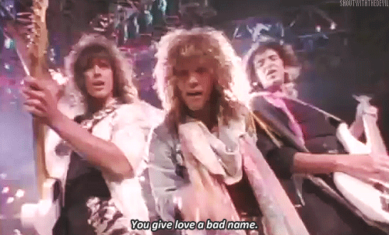
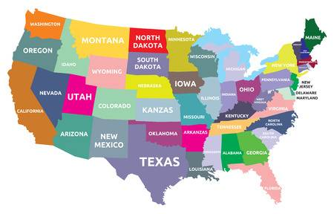
2010
Who?
Where?
Look like?
What’s new?
When?
1986

Slide 2
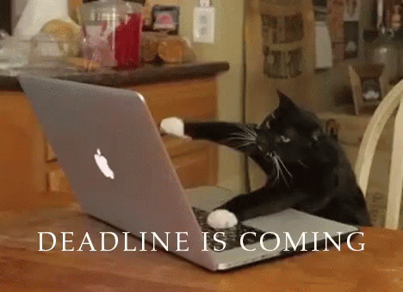
Deadline: 11/12 (Monday)

Slide 3
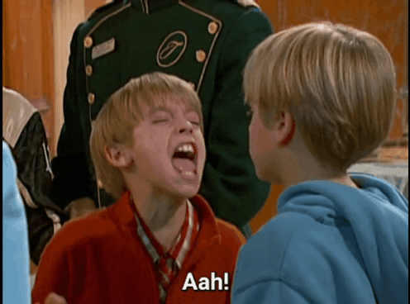
Let’s learn the conversation from the episode of The ghost of Suite 613.

Slide 4
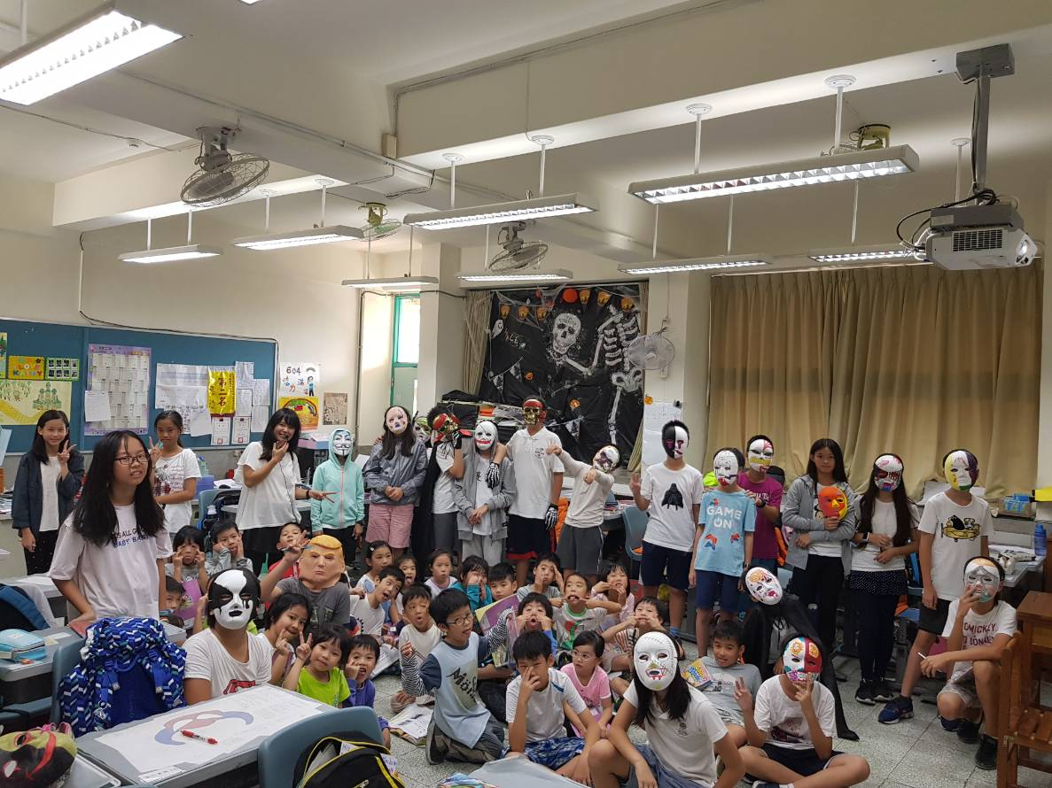
Thank you so much to Class 603 & 604!!

Slide 5
1. Everybody takes turns to throw the dice.
2. Get the number, all the group members read the word.
3. Correct answer, move the token on it.
4. Let’s see which team will be the first to get 6 pizzas.
5. The first 2 groups can get 3 points. The 3rd & 4th group get 2 points. The last group just can get 1 point.

Slide 6
My followers, get 6 pizzas for me!! Right now.

Slide 7
Pop song: It’s my life

Slide 9
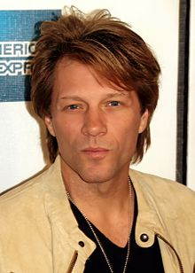
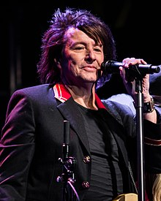
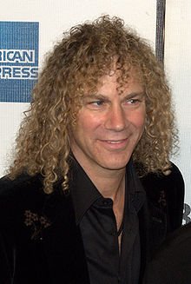
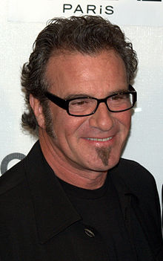
邦喬飛（Bon Jovi）是來自美國新澤西賽瑞維爾市的硬搖滾樂團，由主唱瓊·邦喬飛（Jon Bon Jovi）於1983年創立，成員有吉他手Richie Sambora，鍵盤手David Bryan，和
鼓手Tico Torres。邦喬飛樂團在1980年代紅遍全球，邦喬飛至今已在全世界賣出了1.2億張唱片《It's My Life》是邦喬飛樂團(Bon Jovi)在2000年推出的搖滾歌曲，也這是邦喬飛回歸硬搖滾的重要作品。

Slide 12
This ain't a song for the broken-hearted No silent prayer for the faith -departed I ain't gonna be just a face in the crowd You're gonna hear my voice When I shout it out loud

Slide 14
It's my life It's now or never I ain't gonna live forever I just want to live while I'm alive It's my life My heart is like an open highway Like Frankie said I did it my way I just wanna live while I'm alive It's my life

Slide 16
This is for the ones who stood their ground
For X Tommy and X Gina who never backed down
Tomorrow's getting X harder make no mistake
X Luck ain't even lucky
Got to make your own breaks!
★Chorus

Slide 18
Better stand tall when they're calling you out
Don't bend, don't break, baby, don't back down
★Chorus: x2

Slide 19
【本週英語作業】
1.完成英語期中報告，截止日延至 11/12(一)前繳交。
2.Unit 3單字每個5遍+P35 PartB句型每個2遍。

Slide 20
